Slide 1
B and B+ Trees

Slide 2
What is an M-ary Search Tree?
Maximum branching factor of M
Complete tree has depth = log_{M}N
Each internal node in a complete tree has M - 1 keys
Binary search tree is a B Tree where M is 2

Slide 3
B-Trees
B-Tree is known as a self-balancing tree as its nodes are sorted in the inorder traversal.
In B-tree, a node can have more than two children.
B-tree has a height of logM N (Where ‘M’ is the order of tree and N is the number of nodes). And the height is adjusted automatically at each update.
In the B-tree data is sorted in a specific order, with the lowest value on the left and the highest value on the right.
To insert the data or key in B-tree is more complicated than a binary tree.

Slide 4
There are some conditions that must be hold by the B-Tree:
  All the leaf nodes of the B-tree must be at the same level.
  Above the leaf nodes of the B-tree, there should be no empty sub-trees.
  B- tree’s height should lie as low as possible.

Slide 5
B Tree
B-Trees are specialized M-ary search trees
Each node has many keys
Subtree between two keys x and y contains values v such that x ≤ v < y
Binary search within a node to find correct subtree
Each node takes one full {page, block, line}
of memory (disk)
3
7
12
21
x<3
3<x<7
7<x<12
12<x<21
21<x

Slide 6
B-Tree Properties
Properties
  maximum branching factor of M
  the root has between 2 and M children or at most M-1 keys
  All other nodes have between ⎡M/2⎤ and M records
    Keys+data
Result
  tree is O(log M) deep
  all operations run in O(log M) time
  operations pull in about M items at a time
Notes:
All the other internal nodes (non-leaves) will have between M/2 and M children.
The funky symbol is ceiling, the next higher integer above the value.
The result of this is that the tree is “pretty” full. Not every node has M children but they’ve all at least got M/2 (a good number).
Internal nodes contain only search keys.
A search key is a value which is solely for comparison; there’s no data attached to it.
The node will have one fewer search key than it has children (subtrees) so that we can search down to each child.
The smallest datam between two search keys is equal to the lesser search key.
This is how we find the search keys to use.

Slide 7
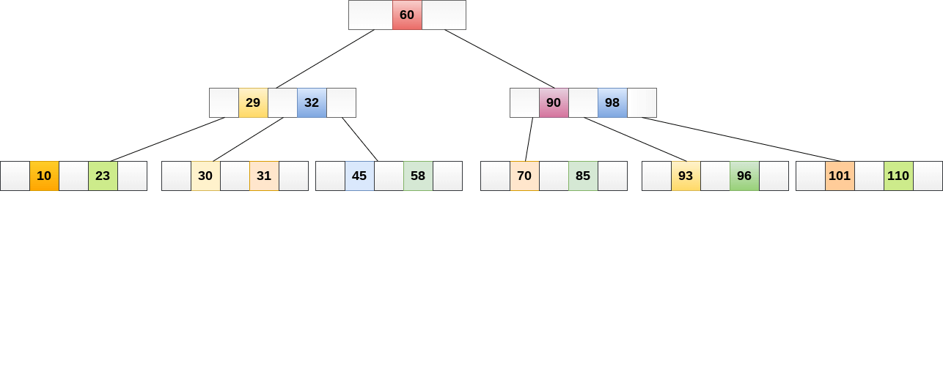

Slide 8
Searching
Searching in B Trees is similar to that in Binary search tree. For example, if we search for an item 49 in the following B Tree. The process will something like following :
Compare item 49 with root node 78. since 49 < 78 hence, move to its left sub-tree.
Since, 40<49<56, traverse right sub-tree of 40.
49>45, move to right. Compare 49.
match found, return.
Searching in a B tree depends upon the height of the tree.
The search algorithm takes O(log n) time to search any element in a B tree.

Slide 9
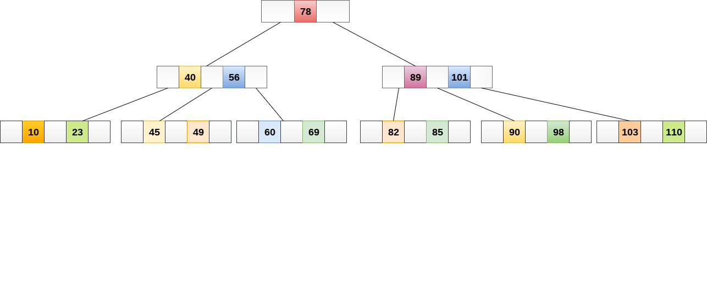

Slide 10
Inserting
Insertions are done at the leaf node level. The following algorithm needs to be followed in order to insert an item into B Tree.
Traverse the B Tree in order to find the appropriate leaf node at which the node can be inserted.
If the leaf node contain less than m-1 keys then insert the element in the increasing order.
Else, if the leaf node contains m-1 keys, then follow the following steps.
  Insert the new element in the increasing order of elements.
  Split the node into the two nodes at the median.
  Push the median element upto its parent node.
  If the parent node also contain m-1 number of keys, then split it too by following the same steps.

Slide 11
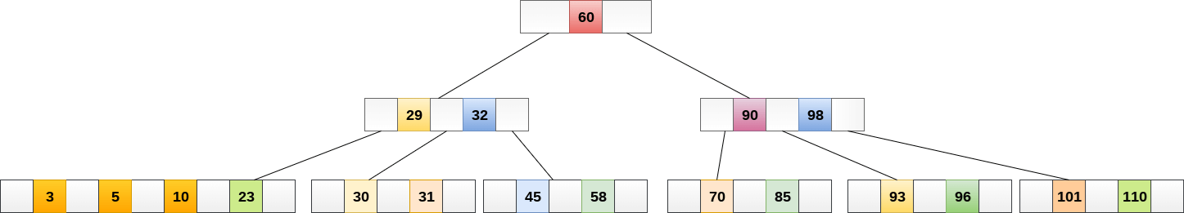
Insert the node 8 into the B Tree of order 5 shown in the following image.

Slide 12
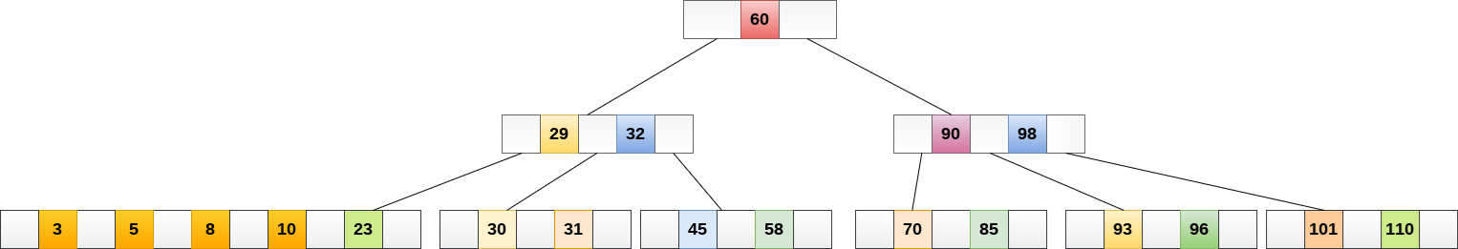
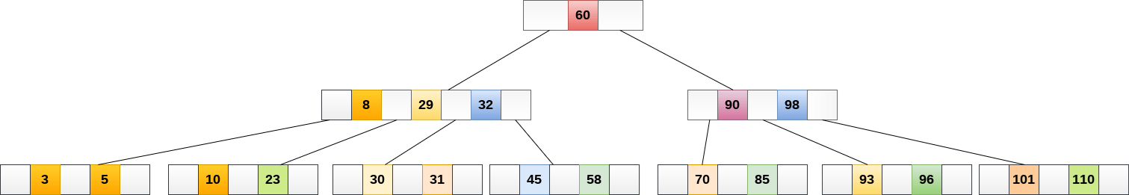
The node, now contain 5 keys which is greater than (5 -1 = 4 ) keys. Therefore split the node from the median i.e. 8 and push it up to its parent node shown as follows.

Slide 13
Deletion
Deletion is also performed at the leaf nodes. The node which is to be deleted can either be a leaf node or an internal node. Following algorithm needs to be followed in order to delete a node from a B tree.
Locate the leaf node.
If there are more than m/2 keys in the leaf node then delete the desired key from the node.
If the leaf node doesn't contain m/2 keys then complete the keys by taking the element from right or left sibling.
  If the left sibling contains more than m/2 elements then push its largest element up to its parent and move the intervening element down to the node where the key is deleted.

Slide 14
  If the right sibling contains more than m/2 elements then push its smallest element up to the parent and move intervening element down to the node where the key is deleted.
If neither of the sibling contain more than m/2 elements then create a new leaf node by joining two leaf nodes and the intervening element of the parent node.
If parent is left with less than m/2 nodes then, apply the above process on the parent too.
If the node which is to be deleted is an internal node, then replace the node with its in-order successor or predecessor. Since, successor or predecessor will always be on the leaf node hence, the process will be similar as the node is being deleted from the leaf node.

Slide 15

Example
Delete the node 53 from the B Tree of order 5 shown in the following figure.
53 is present in the right child of element 49. Delete it.

Slide 16
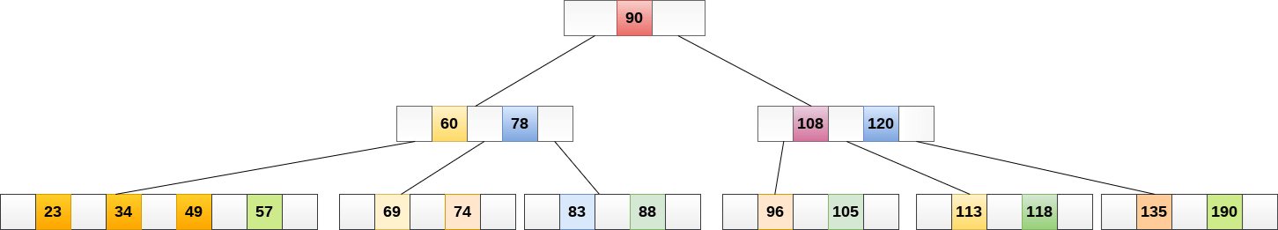
Now, 57 is the only element which is left in the node, the minimum number of elements that must be present in a B tree of order 5, is 2. it is less than that, the elements in its left and right sub-tree are also not sufficient therefore, merge it with the left sibling and intervening element of parent i.e. 49.
The final B tree is shown as follows.

Slide 17
Definition of a B+Tree
The B+ tree is a balanced binary search tree. It follows a multi-level index format.
In the B+ tree, leaf nodes denote actual data pointers. B+ tree ensures that all leaf nodes remain at the same height.
In the B+ tree, the leaf nodes are linked using a link list. Therefore, a B+ tree can support random access as well as sequential access.

Slide 18
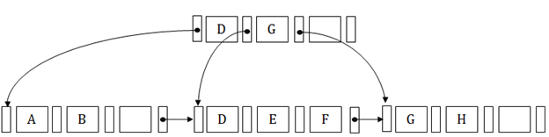
Structure of B+ Tree
In the B+ tree, every leaf node is at equal distance from the root node. The B+ tree is of the order n where n is fixed for every B+ tree.
It contains an internal node and leaf node.

Slide 19
Internal node
  An internal node of the B+ tree can contain at least n/2 record pointers except the root node.
  At most, an internal node of the tree contains n pointers.
Leaf node
  The leaf node of the B+ tree can contain at least n/2 record pointers and n/2 key values.
  At most, a leaf node contains n record pointer and n key values.
  Every leaf node of the B+ tree contains one block pointer P to point to next leaf node.

Slide 20
Example
B+ Tree with M = 4
Often, leaf nodes linked together
10
40
3
15
20
30
50
1
2
10
11
12
20
25
26
40
42
3
5
6
9
15
17
30
32
33
36
50
60
70
Notes:
This is just an example B-tree. Notice that it has 24 entries with a depth of only 2.
A BST would be 4 deep.
Notice also that the leaves are at the same level in the tree. I’ll use integers as both key and data, but we all know that that could as well be different data at the bottom, right?

Slide 21
Advantages of B+ tree usage for databases
keeps keys in sorted order for sequential traversing
uses a hierarchical index to minimize the number of disk reads
uses partially full blocks to speed insertions and deletions
keeps the index balanced with a recursive algorithm
In addition, a B+ tree minimizes waste by making sure the interior nodes are at least half full. A B+ tree can handle an arbitrary number of insertions and deletions.

Slide 22
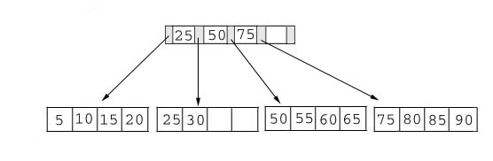
Searching
Just compare the key value with the data in the tree, then return the result.
For example: find the value 45, and 15 in below tree.

Slide 23
Searching
Result:
1. For the value of 45, not found.
2. For the value of 15, return the position where the pointer located.

Slide 24
Insertion
inserting a value into a B+ tree may unbalance the tree, so rearrange the tree if needed.
Example #1: insert 28 into the below tree.
25 28 30
Fits inside the leaf

Slide 25
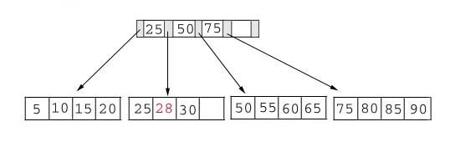
Insertion
Result:

Slide 26
Insertion
Example #2: insert 70 into below tree

Slide 27
Insertion
Process: split the leaf and propagate middle key up the tree
50 55 60 65 70
Does not fit inside the leaf
50 55
60 65 70

Slide 28
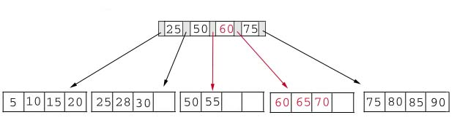
Insertion
Result: chose the middle key 60, and place it in the index page between 50 and 75.

Slide 29
Insertion
The insert algorithm for B+ Tree
Leaf Node Full | Index Node Full | Action
NO | NO | Place the record in sorted position in the appropriate leaf page
YES | NO | Split the leaf node Place Middle Key in the index node in sorted order. Left leaf node contains records with keys below the middle key. Right leaf node contains records with keys equal to or greater than the middle key.
YES | YES | Split the leaf node. Records with keys < middle key go to the left leaf node. Records with keys >= middle key go to the right leaf node. Split the index node. Keys < middle key go to the left index node. Keys > middle key go to the right index node. The middle key goes to the next (higher level) index node. IF the next level index node is full, continue splitting the index nodes.

Slide 30
Insertion
Exercise: add a key value 95 to the below tree.
75 80 85 90 95
Leaf node full, split the leaf.
75 80
85 90 95
25 50 60 75 85
Notes:
Add 95 to 75, 80, 85, 90; node full. Split into: 75, 80 and 85, 90 95. Propagate middle value (85) to parent.
Parent is full with 25, 50, 60, 75. Split into 25, 50 and 60, 75, 85. Propagate middle value (60) up the tree.

Slide 31
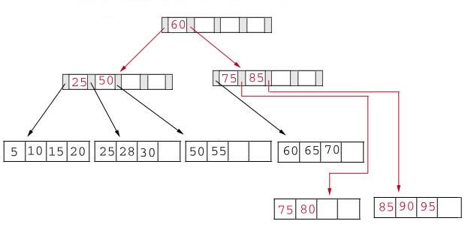
Insertion
Result: again put the middle key 60 to the index page and rearrange the tree.
Notes:
B+ Trees grow UP from the bottom

Slide 32
Deletion
Same as insertion, the tree has to be rebuild if the deletion result violate the rule of B+ tree.
Example #1: delete 70 from the tree
OK. Node >=50% full
60 65

Slide 33
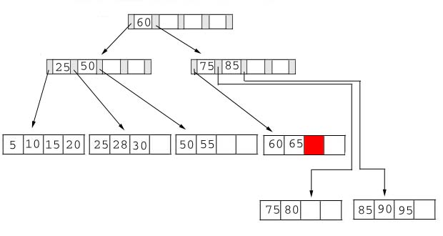
Deletion
  Result:
Notes:
Locate it in the leaf node. Delete it. Node is still >= 50% full, all done.

Slide 34
Deletion
Example #2: delete 25 from below tree, but 25 appears in the index page.
But…
28 30
This is OK.
Notes:
Locate 25 in leaf. Delete it. Node still >= 50% full so okay.
BUT, 25 was used in index node….
Propagate smallest value in leaf node (28) up the tree to replace it.

Slide 35
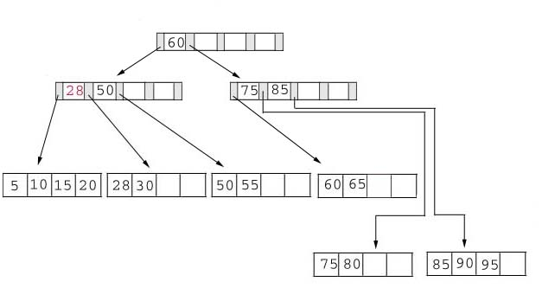
Deletion
Result: replace 28 in the index page.
Add 28

Slide 36
Deletion
Example #3: delete 60 from the below tree
65
Less than 50% full
50 55 65
Notes:
Locate 60 in leaf node Delete it. Leaf now < 50% full.
Neighbor at most 50% full, so merge with neighbor to the right. Guaranteed to fit.

Slide 37
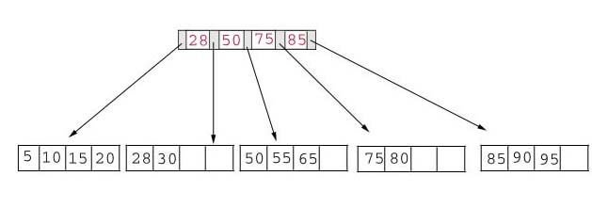
Deletion
Result: delete 60 from the index page and combine the rest of index pages.

Slide 38
Deletion
Delete algorithm for B+ trees
Data Page Below Fill Factor | Index Page Below Fill Factor | Action
NO | NO | Delete the record from the leaf page. Arrange keys in ascending order to fill void. If the key of the deleted record appears in the index page, use the next key to replace it.
YES | NO | Combine the leaf page and its sibling. Change the index page to reflect the change.
YES | YES | Combine the leaf page and its sibling. Adjust the index page to reflect the change. Combine the index page with its sibling. Continue combining index pages until you reach a page with the correct fill factor or you reach the root page.

Slide 39
Conclusion
For a B+ Tree:
It is “easy” to maintain its balance
  Insert/Deletion complexity O(log_{M/2})
The searching time is shorter than most of other types of trees because branching factor is high

Slide 40
B+Trees and DBMS
  Used to index primary keys
  Can access records in O(log_{M/2}) traversals (height of the tree)
  Interior nodes contain Keys only
    Set node sizes so that the M-1 keys and M pointers fits inside a single block on disk
      E.g., block size 4096B, keys 10B, pointers 8 bytes
      (8+ (10+8)*M-1) = 4096
      M = 228; 2.7 billion nodes in 4 levels
    One block read per node visited

